Slide 1


Y9 PSHE
Suggested answers on next slide
Warm-up – MWBS Write down three words that come to mind when you hear the term “healthy relationship.” (example: trust...) | 2. Recall – from last lesson In what ways do you think media (TV, social media, movies) can affect how people see themselves or others? Positive? Negative? Write 2-3 sentences explaining your thoughts.
4. Thinking hard.
Think about what it means to have a “positive body image.”
Describe in your own words what a positive body image is and why it’s important.
Notes:
Trust, communication, respect, feeling safe, similar values etc

Slide 2
THE LEARNING JOURNEY
Year 9 PSHE/RSE – Topic 1b– Maturing Relationships and Risks
LEARNING FOCUS –Title: How Does Pornography Negatively Impact Individuals and Relationships?
SUCCESS QUESTIONS:
Can I understand key terms related to pornography and its influence on relationships?
Can I discuss the ways pornography can impact mental health, body image, and relationship expectations?
Can I consider case studies that illustrate these effects?
Can I reflect on and consolidate my learning about healthy relationships, consent, and personal boundaries?
Today’s lesson
Notes:
Today’s lesson focus

Slide 3

PSHE ground rules
In PSHE we will cover a wide range of topics, and will include topics that some people might disagree about, or find difficult to discuss. We will follow some key rules to respect others:
We join in and ask questions if we want to.
We make sure that everybody feels listened to.
We make sure everybody feels ok – we don’t put people down or make personal comments.
We use the correct vocabulary, not slang. If we are unsure we ask the teacher.
We keep the conversation in the room.
We know we can ask for further help or advice if we want to.

Slide 4
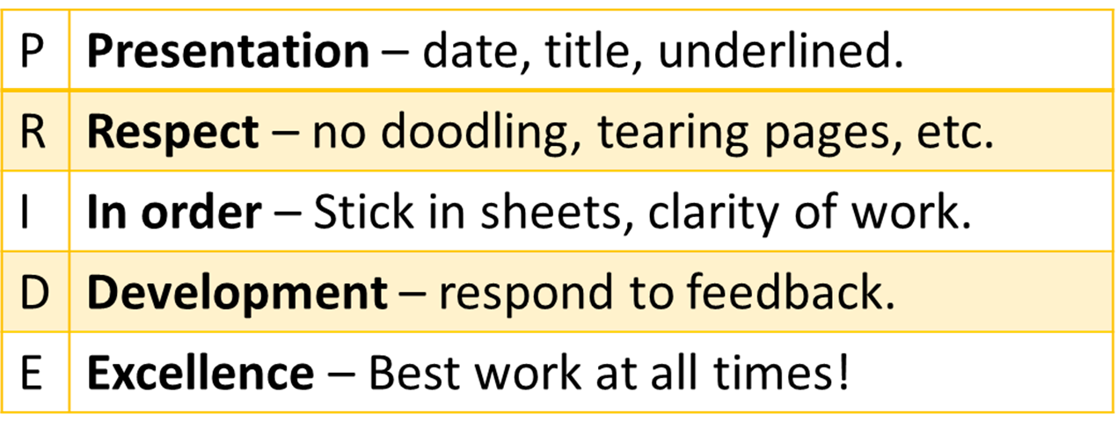
PSHE presentation - PRIDE
We will complete our work in our PSHE books.
These must be kept in good condition following the usual high expectations in school.
There should be a date written in full, and a title.
Complete work in full sentences to the best of your ability.
No doodling or graffiti.
Neatly stick loose sheets in.

Slide 5
Title: How Does Pornography Negatively Impact Individuals and Relationships?
Learning Objectives:
By the end of this lesson, students will:
Understand key terms related to pornography and its influence on relationships.
Explore and discuss the ways pornography can impact mental health, body image, and relationship expectations.
Consider case studies that illustrate these effects.
Reflect on and consolidate their learning about healthy relationships, consent, and personal boundaries.

Slide 6
What is pornography?
Key words: Pornography
Often called porn, it is printed or visual material containing the explicit description or display of sexual organs or activity, intended to stimulate sexual excitement.

Slide 7
True or False Task: Understanding the Impact of Pornography
On the next few slides will be a range of statements about pornography.
Read each statement and decide if it is True or False. After answering, read the explanations to learn more about each concept.
Notes:
Teacher notes: Students can use mini-whiteboards to show their responses or students could move to a side of the classroom representing true or false then review each statement as a class to discuss the answers and explanations.
Reflection: After going over the answers, ask students to share any new insights or areas they’d like to learn more about, encouraging questions and open discussion.
This task will help reinforce key concepts about healthy relationships, boundaries, and the realistic impacts of media on self-esteem and expectations.

Slide 8
True or False
Statement: Pornography often presents realistic portrayals of relationships and people’s bodies.
Answer: False
Pornography often shows idealised and unrealistic portrayals of both bodies and relationships. It does not represent the diversity of real bodies or the dynamics of healthy relationships, often ignoring aspects like consent, respect, and emotional connection.

Slide 9
True or False
Statement: Watching pornography regularly can lead to lower self-esteem and body image issues in some people.
Answer: True
Regular exposure to idealised images in pornography can make people feel insecure about their own bodies, as they may start comparing themselves to unrealistic standards. This can negatively impact self-esteem and body image.

Slide 10
True or False
Statement: Consent is always shown as important in pornography.
Answer: False
Consent is rarely emphasised in pornography. This lack of emphasis can lead viewers, especially young ones, to misunderstand or overlook the importance of consent in real-life relationships, where it is essential for healthy interactions.

Slide 11
True or False
Statement: Being open about personal boundaries and comfort levels is part of a healthy relationship.
Answer: True
A healthy relationship involves open communication about boundaries, comfort levels, and expectations. Respecting each other’s boundaries ensures both partners feel safe and valued.

Slide 12
True or False
Statement: Watching pornography can sometimes create unrealistic expectations for how people should look or act in relationships.
Answer: True
Pornography can set unrealistic expectations for physical appearance and behaviour. These expectations can put pressure on individuals to act or look in certain ways, which is often unhealthy and unrealistic.

Slide 13
True or False
Statement: It’s okay to feel pressured to do something in a relationship if it’s what your partner wants.
Answer: False
Feeling pressured is a sign that boundaries may not be respected. Healthy relationships are built on mutual respect and understanding, and no one should feel compelled to do something they’re uncomfortable with just to please a partner.

Slide 14
True or False
Statement: Someone who feels that they cannot control their habit of watching pornography should reach out for support.
Answer: True
Seeking support is a healthy and responsible step. Talking to a trusted adult, counsellor, or mental health professional can provide guidance and help with managing habits or developing healthy coping strategies.

Slide 15
True or False
Statement: Pornography is a reliable source for learning about real-life relationships and intimacy.
Answer: False
Pornography does not provide realistic information about relationships or intimacy, as it often lacks depictions of emotional connection, consent, communication, and respect. Real-life relationships require understanding, compromise, and emotional intimacy that is usually not depicted in pornography.

Slide 16
True or False
Statement: A person’s self-worth should be based on how similar they look to the people in the media.
Answer: False
Self-worth should be based on personal qualities, values, and accomplishments, not on comparisons with idealised media images. Media, including pornography, often depicts unrealistic standards that can harm self-esteem when used as a benchmark.

Slide 17
True or False
Statement: People who feel uncomfortable about their partner’s behaviour should discuss it openly and set boundaries.
Answer: True
Open communication and boundary-setting are vital in healthy relationships. If something makes a person uncomfortable, discussing it respectfully with their partner can help build trust and mutual understanding.

Slide 18

Match the different types of illegal pornography
with their correct meanings
Sharing images or videos of someone else without their consent with the intention to cause them distress or embarrassment.
A
Child Pornography
Pornography that involves anyone under the age of 18.
B
Revenge Pornography
Sending or receiving sexually explicit messages. It is illegal for anyone under the age of 18 to do this.
C
Sexting
Task
What can the government do to stop all of these above?
What could happen if you send a sexually explicit image (A sext message) to a friend, loved one or partner?
Challenge

Slide 19

Key Aspect of the Law on Pornography
Revenge Porn
Known as Image Based Sexual Abuse
This criminal offence broadly has three elements which need to be proven:
1. Disclosure of a private sexual photograph or film
2. Without the consent of the person depicted
3. With the intention of causing that individual distress
Punishable by up to 2 years in prison
Criminal Justice Act 2015 – Revenge Porn
Child Porn
It is illegal to take, make, distribute, show or possess for the intent of showing or distributing an indecent photograph.
These are punishable by up to 14 years in prison.
Protection of Children Act 1978 ("the 1978 Act") – Child Porn

Slide 20
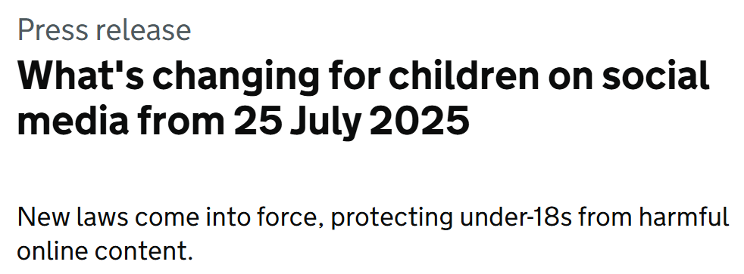
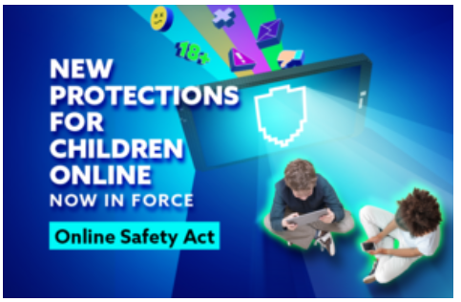
UK law on watching pornography - update
From 25 July, the way children experience the internet will fundamentally change, as new laws come into force, protecting under-18s from harmful content they shouldn’t ever be seeing. This includes:
pornography
self-harm
suicide
hate speech
violence
Children will have to prove their age to access the most harmful material on social media and other sites, with platforms having to use secure methods like facial scans, photo ID and credit card checks to check the age of their users. This means it will be much harder for under-18s to accidentally or intentionally access harmful content.
A thousand platforms have confirmed to Ofcom they’ve got these checks in place, including the most visited porn site in the UK, PornHub.
It comes as Ofcom figures show that children as young as 8 have accessed pornography online, and 16% of teenagers report seeing material that stigmatises body types or promotes disordered eating in the last 4 weeks.
Children will also see fewer harmful posts and videos in their feeds, with platforms required to make sure their algorithms aren’t feeding children content that promotes harmful behaviours like bullying, hate speech or dangerous online challenges.
And when harmful content does appear, platforms will need to act quickly to remove it. If children are seeing something harmful or inappropriate, it will be easier to find help and report it.

Slide 21
Task: Strategies for Managing Exposure
Small group activity
Task Instructions:
In this activity, you will work in small groups looking at various real-life scenarios, brainstorming and discussing strategies for managing exposure to pornography and resisting peer pressure to view explicit content.
Notes:
Form small groups of 3-4 students.
Discuss the potential risks and negative effects of consuming pornography that were mentioned in the previous activity.
Brainstorm and list strategies for managing exposure to pornography and resisting peer pressure.
Choose one or two of the most effective strategies and develop scenarios that illustrate how they can be applied in real-life situations.
Present your scenarios to the class and explain how the chosen strategies can help individuals make informed decisions and protect themselves from the potential harms of pornography.
Note to Teachers: Encourage students to think critically about each scenario and consider the potential consequences of their actions. Emphasize the importance of respecting personal boundaries, making informed decisions, and seeking support if needed. Provide guidance and support as students work through the task.

Slide 22
Scenario 1: Online Temptation
You and your friends are browsing the internet together when one of them suggests searching for explicit content. You feel uncomfortable and don't want to participate, but you're worried about seeming uncool or being left out. How do you respond?
Notes:
Possible answer: You could respond by calmly stating that you're not comfortable searching for explicit content and suggest doing something else together. You can reinforce your decision by explaining that you prefer to respect yourself and others by not engaging in activities that could be harmful or inappropriate.

Slide 23
Scenario 2: Unwanted Exposure
While watching a movie at a friend's house, a pop-up advertisement for a pornographic website unexpectedly appears on the screen. You feel shocked and don't know what to do. How can you handle this situation?
Notes:
Possible answer: In this situation, you could close the pop-up advertisement immediately and express your discomfort to your friend. You could suggest doing something else or leaving if the content continues to make you uncomfortable. It's essential to communicate your feelings clearly and assert your boundaries while staying calm

Slide 24
Scenario 3: Pressure from Peers
During a sleepover, your friends decide to watch a pornographic video on their phone. They encourage you to join them, but you don't feel comfortable. How do you assert your boundaries and resist peer pressure?
Notes:
Possible answer: You could assert your boundaries firmly but respectfully by saying something like, "I appreciate your invitation, but I'm not comfortable watching that kind of content. Let's find something else to do together.“ It's important to stand firm in your decision and not give in to peer pressure, even if your friends insist.

Slide 25
Scenario 4: Curiosity Strikes
You come across a link to a pornographic website while browsing social media. You're curious and tempted to click on it, but you remember the potential risks and negative effects of consuming pornography. What do you do?
Notes:
Possible answer: You should resist the temptation to click on the link and close the social media app or browser immediately. Remind yourself of the potential risks and negative effects of consuming pornography, and distract yourself by engaging in a different activity or talking to a trusted adult about your feelings.

Slide 26
Scenario 5: Unexpected Encounter
While walking home from school, you stumble upon a discarded magazine with explicit images. You feel shocked and unsure of what to do next. How can you handle this unexpected encounter and protect yourself from further exposure?
Notes:
Possible answer: You should immediately walk away from the discarded magazine and avoid looking at it further. If possible, you could inform a trusted adult or authority figure about the situation, such as a teacher or parent, so they can take appropriate action to remove the magazine and ensure the safety of others. It's crucial to protect yourself from further exposure and seek support if needed.

Slide 27
Where to go for support?
Speak to a parent, tutor, head of year or trusted member of staff
Contact Childline www.childline.org.uk/info-advice/bullying-abuse-safety/online-mobile-safety/online-porn
Find out more on Thinkuknow: www.thinkuknow.co.uk/14_plus/Need-advice/Porn
Contact CEOP www.ceop.police.uk/Safety-Centre (to report abuse online)
Call the police (999 for an emergency, 101 to report a non-urgent crime)
Contact Victim Support: www.victimsupport.org.uk

Slide 28

Reflect on what you learnt today and how to apply it in daily life.
In today’s lesson, I have learnt about...
PSHE End of lesson learning review
Homework:
Your tutor will send you an online homework quiz on the topics covered so far this term. You must complete this as usual for homework.
In your books, in red pen:
Can you remember what the law is in the UK around pornography – what age do you have to be to watch pornography in the UK?
What checks are now in place to prevent U18's from accessing pornography?
Identify at least 3 trusted sources of support and guidance thatyou can turn to if you encounter difficult situations related topornography. This may include parents, teachers, schoolcounsellors, helplines, or online resources.
​
PRIDE​
Are all dates and titles underlined?​
Are all your sheets glues in?
Notes:
Teacher:
In silence students should spend at least 7-10 mins writing out a reflection of what they've learnt today and some key takeaways to keep themselves healthy & ensuring they are familiar with self-examination.
For SEND students: you might want to print the next slide and ask them to stick it in books and fill out the paper.

Slide 29
Reflect on what you learnt today and how to apply it in daily life.
PSHE End of lesson learning review
Write down in red pen:
three key takeaways from the lesson
two trusted sources of support you can turn to if you are in a difficult situation related to pornography. This may include parents, teachers, school counsellors, helplines, or online resources.
In today’s lesson, I have learnt about... _________________________________________________________________
Two strategies I will use to make sure I have support… __________________________________________________________________________________________________________________________________
​
PRIDE​
Are all dates and titles underlined?​
Are all your sheets glues in?
Notes:
Teacher – SEND students' slide (1)
In silence students should spend at least 7-10 mins writing out a reflection of what they've learnt today and some key takeaways on how to access support on difficult topics as well as how to stay safe.

